Slide 1


Quick Learning App
FALL 2022 CAPSTONE PROJECT
GUIDED BY:- Prof. Henry Wong

Slide 2

Agenda:
Feedback
Accountabilities
Problem statement
Project Description
Personas
MVP
Technologies
Diagrams
Sprint Recap
Past sprint and current sprint comparison
Product Backlog
Sprint Backlog
User stories
Test cases
Metrics
Retrospective
Stories committed for Sprint 5
App Demo

Slide 3
Improvements Made:
Need to show the presentation slides in the wiki page.
Create Jira tickets for the improvements that we are making for current spring.
Rename Product Development Cycle to Software Development Cycle.
Need to add Story points in the user stories, sprint backlog, product backlog.
Charts need to be improvised – especially Committed Vs Not Committed.
Need to add the commitments that we made in the current sprint in the sprint backlog.

Slide 4
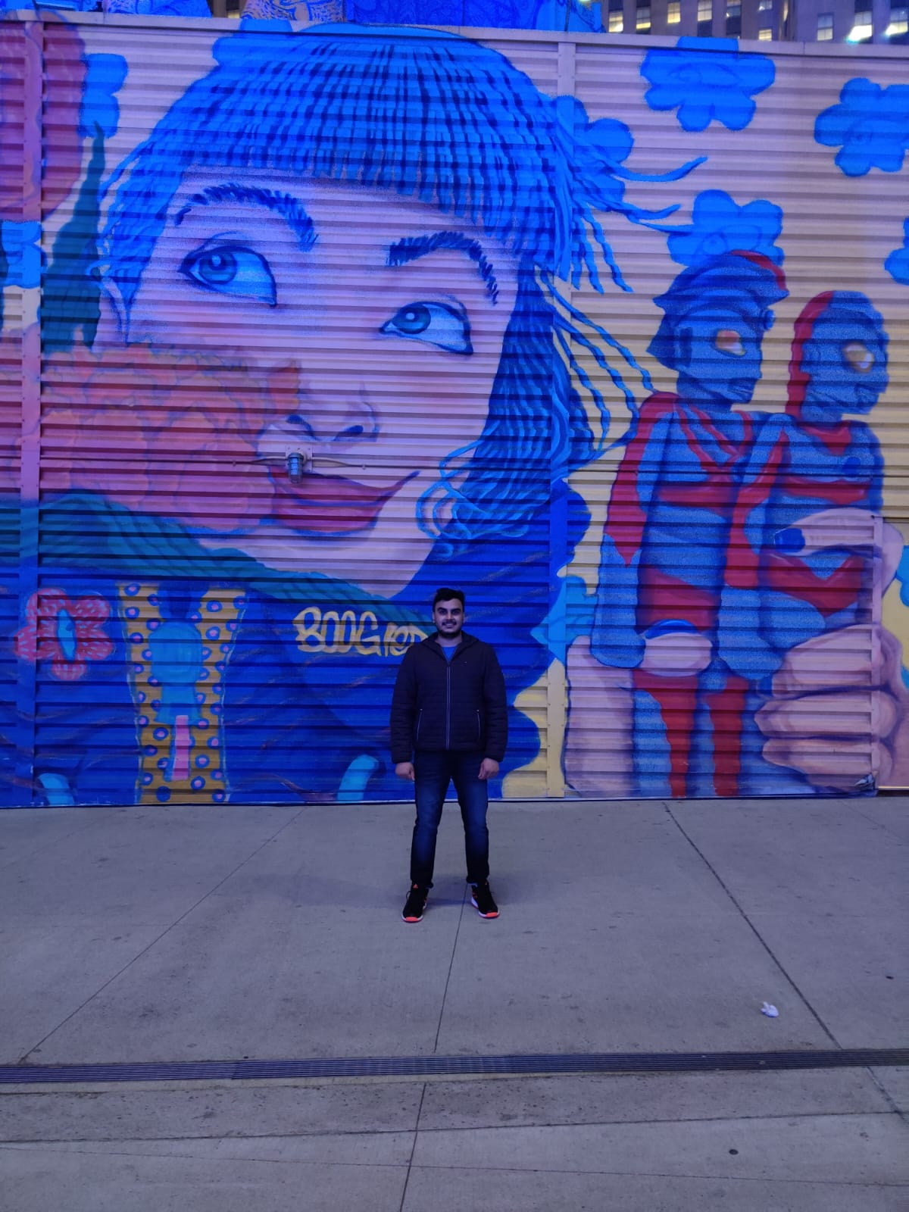


Accountabilities:
Amit Bhayal
Ankush Gurhani
Genius Machado
Software Developer
Software Developer
Software Developer

Slide 5
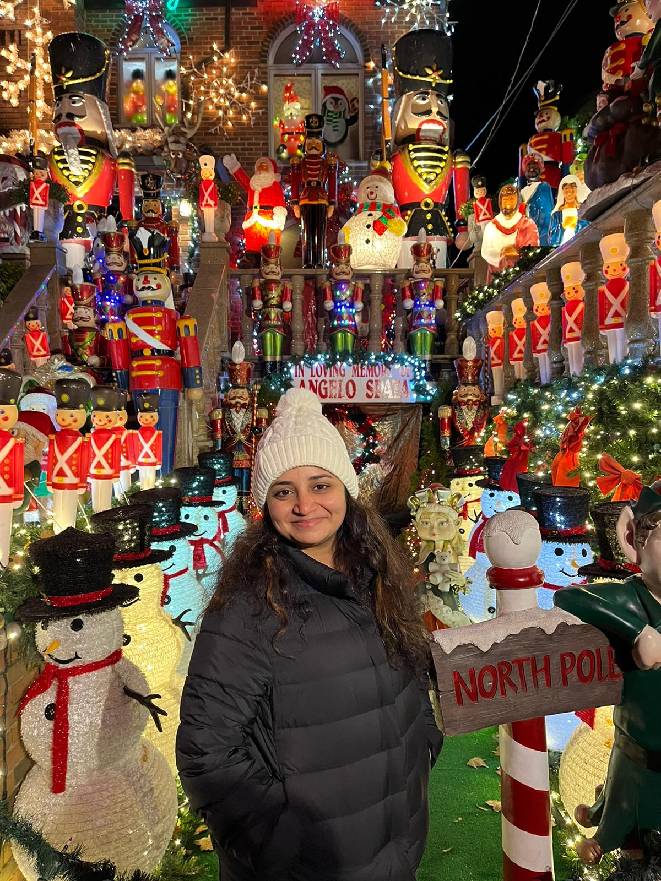


Accountabilities:
Sharanya Dave
Sravani Eata
Usha Sri Tirumalasetty
SDE3 / Database Administrator
Business Analyst/Software Tester
SDE 2/Software Tester

Slide 6

Problem Statement
How Students and Parents know the objective of the subjects taught in the class ?
How the teachers and the student communicate with each other after the school hours ?
How the Parents monitor their kids assignments and learning material ?
How can the current system notify the user about any updates just in time ?

Slide 7

Project Description:
Quick Learning is a software that is designed specifically to create, distribute, and manage the delivery of educational content.
The Quick Learning application can be hosted as a stand-alone product on the company server, or it can be a cloud-based platform that is hosted by the software firm.
The goal of this project is knowledge management which means gathering, organizing, sharing and analysis of an organization's knowledge/resources.

Slide 8


Personas

Slide 9
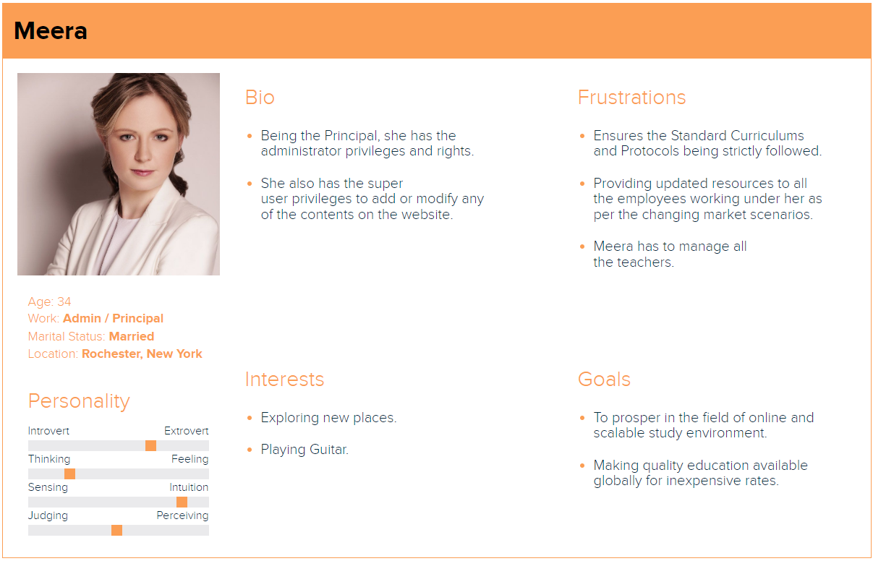

Slide 10
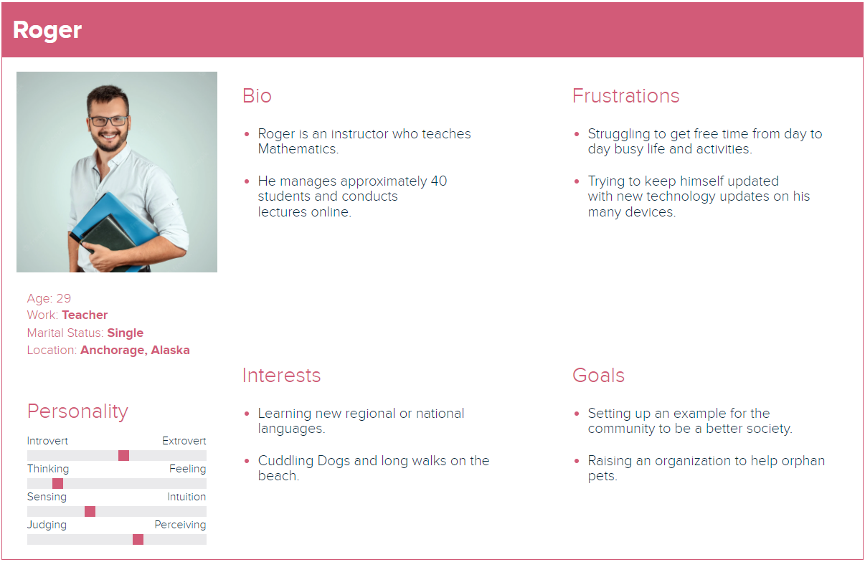

Slide 11
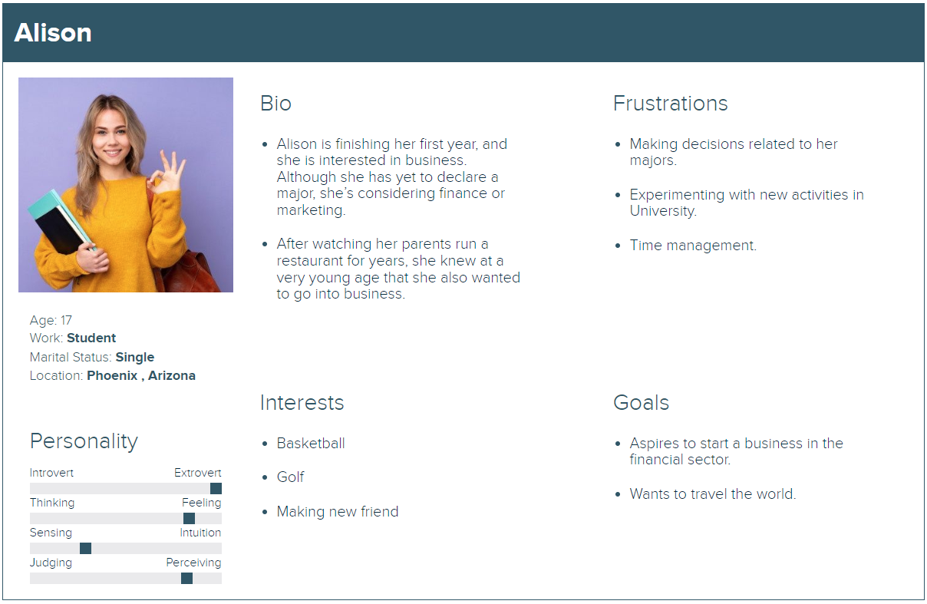

Slide 12
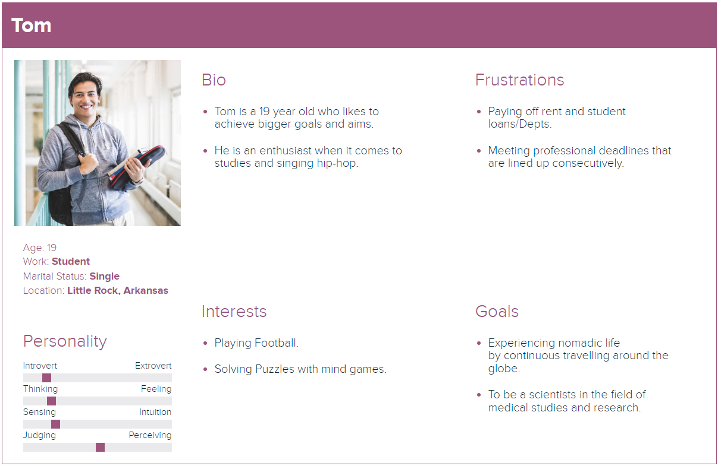

Slide 13

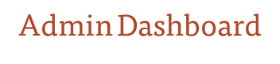

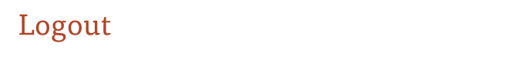
Minimal Viable Product(MVP):
Registration/Signup
User can register into application.
Add and delete course for the Admin.
Login
User can login into the application with valid credentials.
Minimal settings page for admin & enrolment of a student.
User can view the course.
User can Logout from the application.
Instructor Page
Instructor can add course through this page.

Slide 14
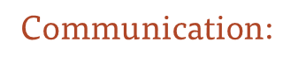











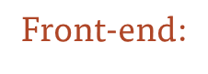




Technologies:
Database:
Back-end:
Code editor:
Project Tracking:
Visual Studio

Slide 15
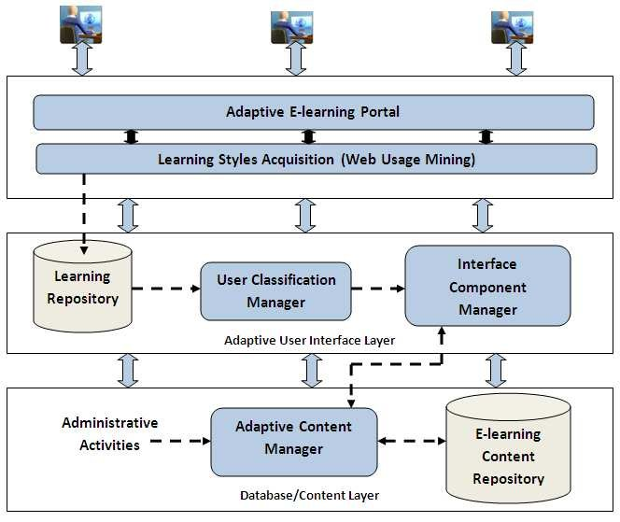
Conceptual Architecture Diagram:

Slide 16
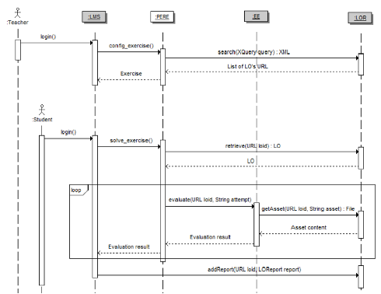
Sequence Diagram

Slide 17
Application Modeling:
Admin
Departments, Courses, Professors, and Students list.
Maintaining and monitoring the professors and student's profile.
Communication channels.
Maintaining and monitoring courses content up-to-date.
Looking into Accounts.
Professor
Upcoming schedules.
List of courses.
Attend live classes.
Uploading course related contents.
Uploading assignments, quizzes and exams.
Give marks and feedbacks.
Monitoring the student's progress.
Conduct Study hours.
Special Classes.
Communication channels.
Quick Learning App
Authentication & Authorization
Student
List of courses.
Weekly schedule.
Personal profile.
Upload assignments, write exams, submit quizzes.
Marks.
Achievements.
Workshops.
Badges.
Certifications.
Downloads.
Important (OR) Saved materials.
Handshake.
Communication channels.
Courses payment details.

Slide 18
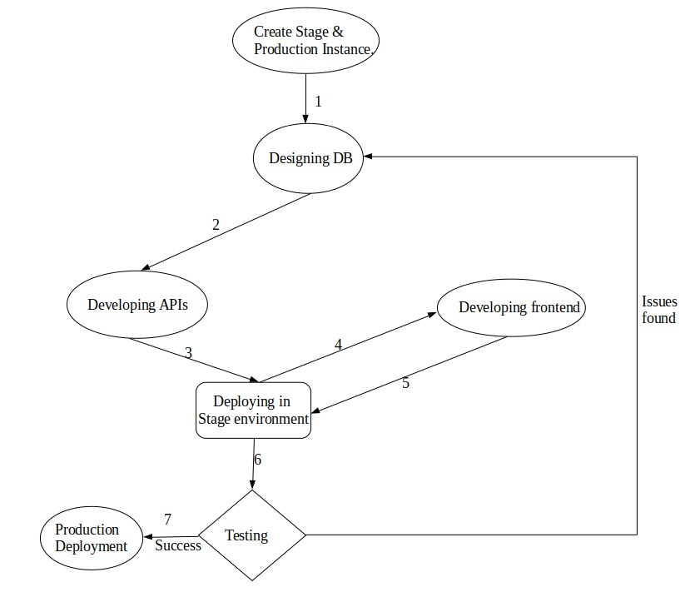







Software Development Cycle:

Slide 19
SPRINT 3 RECAP:
Forgot password
Add Course
List Course
Delete Course
Course Details
PROJECT RECAP:
SignUp
Login
Logout
Create My Account
Update My Account
Forgot password
Add Course
List Course
Delete Course
Course Details

Slide 20
Sprint 3 vs Sprint 4:
Sprint 3 | Sprint 4
Forgot Password | Fixed the issues in course details in the Instructor Page.
Add Course | Wishlist to save courses for the student.
List Course | Sending messages.
Delete Course | Search bar for the courses for the guest.
Course Details | Top 10 courses for guest.

Slide 21
Product Backlog:
Id | Issue Type | Story | Status | Story Points
BREW-107 | Task | Need to encrypt the password while storing in Database. | To-do | --
BREW-108 | Story | As a Student, I want to do the payment so that I can join or able to see the class of the course that I want to learn. | To-do | 8
BREW-109 | Task | Need to add the faster loading pages. | To-do | --
BREW-131 | Story | As a user, I want the content in my language because it is convenient for me. | Planned | --
BREW-112 | Story | As a User, I want to see the notifications, so that I can be able to know the updates. | To-do | 3
BREW-117 | Story | As a student, I want to check my grades, so that I will know my progress. | To-do | 5
BREW-129 | Story | As a Professor, I want to upload the materials for the course, so that students can revise everything that I taught. | To-do | 5
BREW-130 | Story | As a Student, I want to able to see the materials, so that I can revise everything. | To-do | 3

Slide 22
Product Backlog:
Id | Issue Type | Story | Status | Story Points
BREW-132 | Story | As a Student, I want to download the materials, so that I can see them offline as well. | To-do | 3
BREW-133 | Story | As a Professor, I want upload assignments, so that I can check the student's knowledge of my course. | To-do | 5
BREW-134 | Story | As a Student, I want to submit assignments, so that I professor can see my answers. | To-do | 5

Slide 23
Sprint Backlog:
UserStories ID | Summary | Story Point
BREW-123 | As a student I want to save the course to my wishlist So that I can buy it easily | 1
BREW-124 | As an admin I want to send messages to the teachers/students So that I can communicate with them | 3
BREW-125 | As a student I want to send messages to the teachers/admins So that I can communicate with them | 3
BREW-126 | As a professor I want to send messages to the admin/students So that I can communicate with them | 3
BREW-127 | As a guest I want to search for the course So that I can buy them | 3
BREW-128 | As a guest, I want to see the top 10 courses So that I know the demand in the market | 1

Slide 24
User Stories:
User Story Id | Summary | Status
BREW-123 | As a student I want to save the course to my wishlist So that I can buy it easily | Done
 | Scenario The student wants to add the course to his Wishlist Given the student is logged in using the correct credentials When the course is available Then the student can buy it
BREW-124 | As an admin I want to send messages to the teachers/students So that I can communicate with them | Done
 | Scenario The admin wants to send a message to the teachers Given the admin is logged in using the correct credentials When the admin is connected to a network Then the message will be delivered
BREW-125 | As a student I want to send messages to the teachers/admins So that I can communicate with them | Done
 | Scenario The student wants to send a message to the teachers Given the admin is logged in using the correct credentials When the student is connected to a network Then the message will be delivered

Slide 25
User Story Id | Summary | Status
BREW-126 | As a professor I want to send messages to the admin/students So that I can communicate with them | Done
 | Scenario The teacher wants to send a message to the students Given the admin is logged in using the correct credentials When the teacher is connected to a network Then the message will be delivered
BREW-127 | As a guest I want to search for the course So that I can buy them | Done
 | Scenario The guest wants to search for a course Given the web app is live/up When the guest is connected to a network Then the guest can search for a course
BREW-128 | As a guest, I want to see the top 10 courses So that I know the demand in the market | Done
 | Scenario The guest wants to search for a course Given the guest is on the home page When the guest is connected to a network Then the guest see the top 10 course

Slide 26
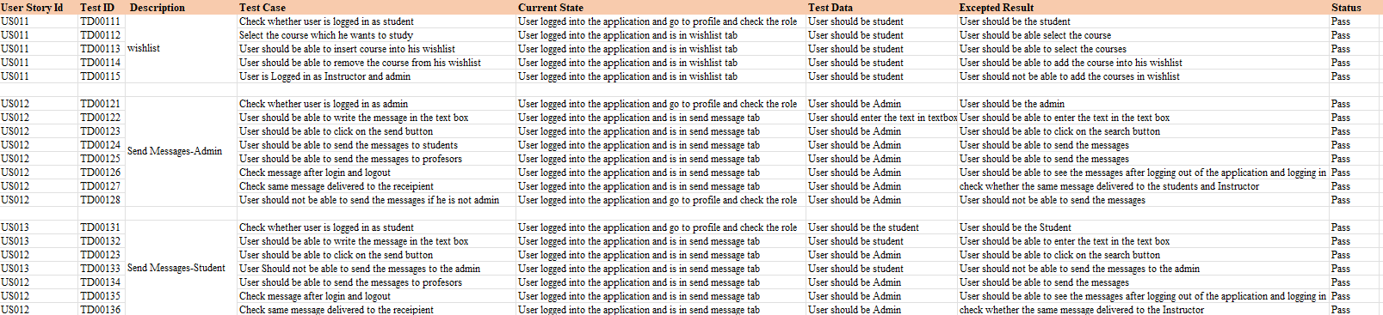
Test Cases:

Slide 27
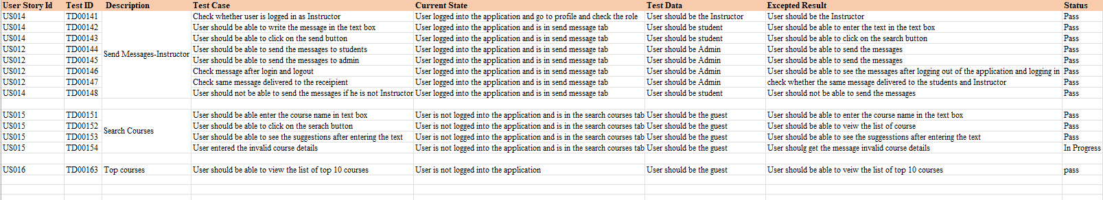
Test Cases:

Slide 28
Stories Completed and Stories Not Completed
UserStory ID | Summary | Story Point | Status
 |  | 1 | Completed
 |  | 3 | Completed
 |  | 3 | Completed
 |  | 3 | Completed
 |  | 3 | Completed
 |  | 1 | Completed
BREW-123
As a student I want to save the course to my wish list So that I can buy it easily
BREW-124
As an admin I want to send messages to the teachers/students So that I can communicate with them
BREW-125
As a student I want to send messages to the teachers So that I can communicate with them
BREW-126
As a professor want to send messages to the admin/students So that I can communicate with them
BREW-127
As a guest I want to search for the course So that I can see the details of the course directly
BREW-128
As a guest, I want to see the top 10 courses So that I know the demand in the market

Slide 29
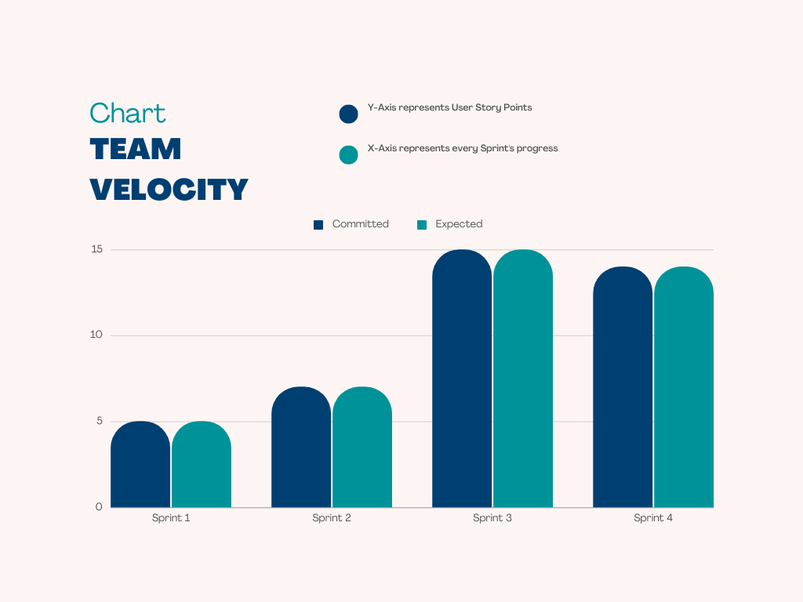
Team Velocity Chart:

Slide 30

Team History Velocity (Average):
Average Velocity is:
(5+7+15+14)/4=10.25

Slide 31
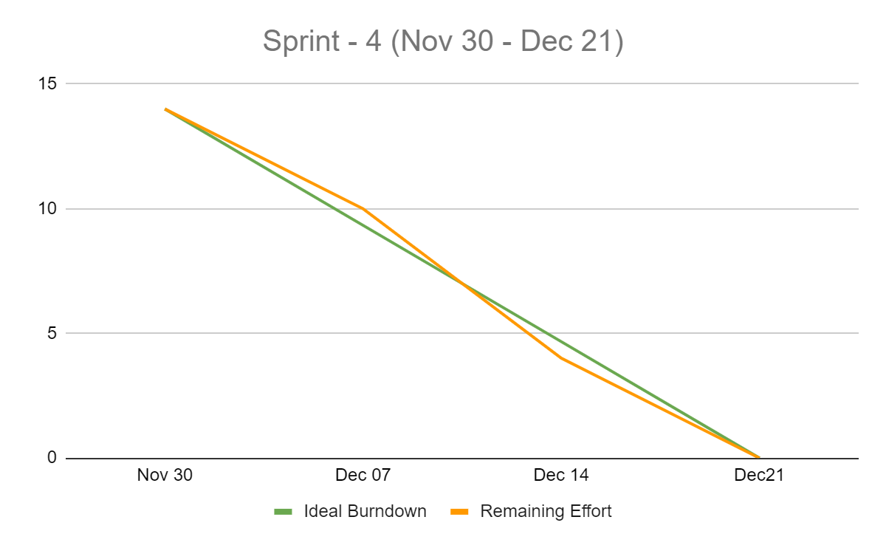
Burndown Chart:
X-Axis represents the progressive dates of Sprint 4.
Y-Axis represents the User Story points of Sprint 4.

Slide 32
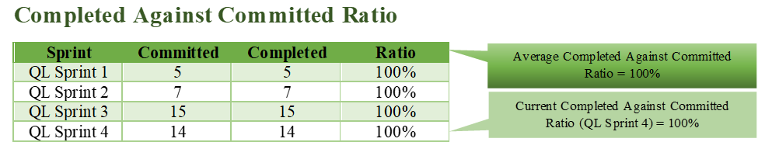
Committed Against Completed Ratio:

Slide 33
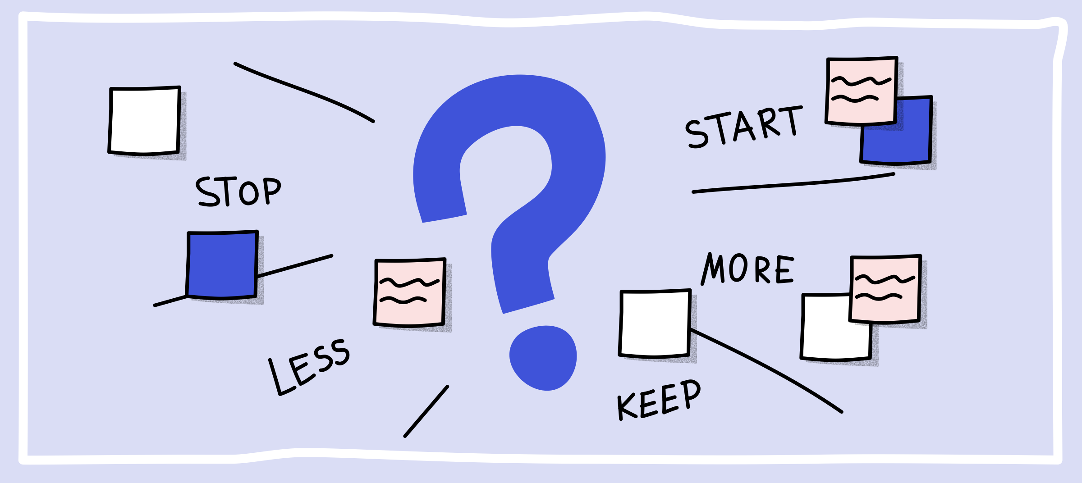
Retrospective

Slide 34
What went well?
Enhanced collaboration, communication, trust and team spirit.
Improved team productivity.
An ability to prevent past mistakes from happening again.
Better anticipation of future problems.
Time Management is efficient.
All members knew what they had to do — and did it!
Backlog items are Prioritized and worked accordingly.
We discussed about the user stories and got the better understanding about it .

Slide 35
What didn’t go well?
Our estimates were bit optimistic
We have not reached our testing goals.
Changing the user stories late in the sprint.
Unexpected bugs raised as the unit testing is not proper.
Find more accurate ways to estimate our user stories.

Slide 36
What needs improvement?
Get better at estimating
User testing should be better developed in the sprint
Hold meeting only when we need to
Set time in each sprint for knowledge sharing
Guarantee all user stories have clear acceptance criteria before picking them up.
Use a more accurate way to estimate the story size

Slide 37
Stories Planned and Committed for Sprint 5:
Story_ID | Stories | Status
BREW-107 | Need to encrypt the password while storing in Database. | To-do
BREW-109 | Need to add the faster loading pages. | To-do
BREW-108 | As a Student, I want to do the payment so that I can join or able to see the class of the course that I want to learn. | To-do
BREW-112 | As a User, I want to see the notifications, so that I can be able to know the updates. | To-do
BREW-129 | As a Professor, I want to upload the materials for the course, so that students can revise everything that I taught. | To-do
BREW-130 | As a Student, I want to able to see the materials, so that I can revise everything. | To-do
BREW-132 | As a Student, I want to download the materials, so that I will be able to access them offline too. | To-do

Slide 38
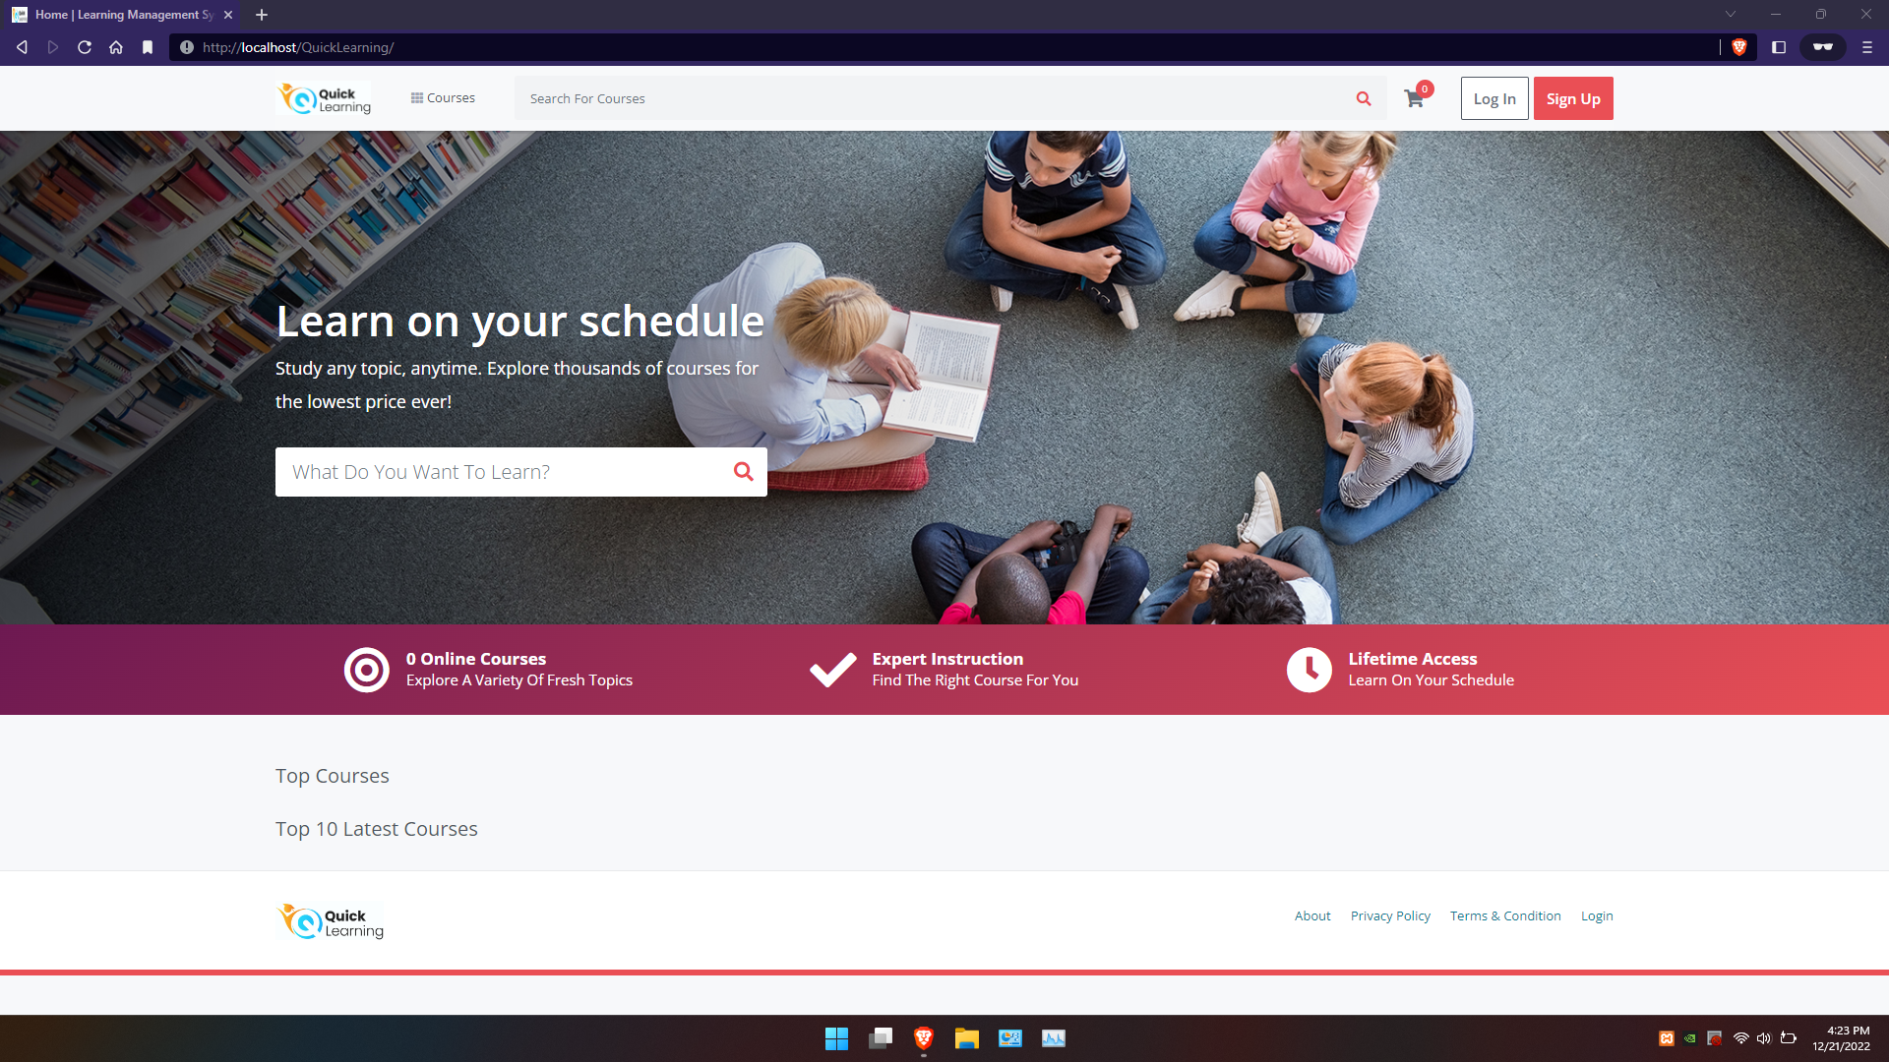
Slides App Screenshot
Front Page with search functionality.

Slide 39
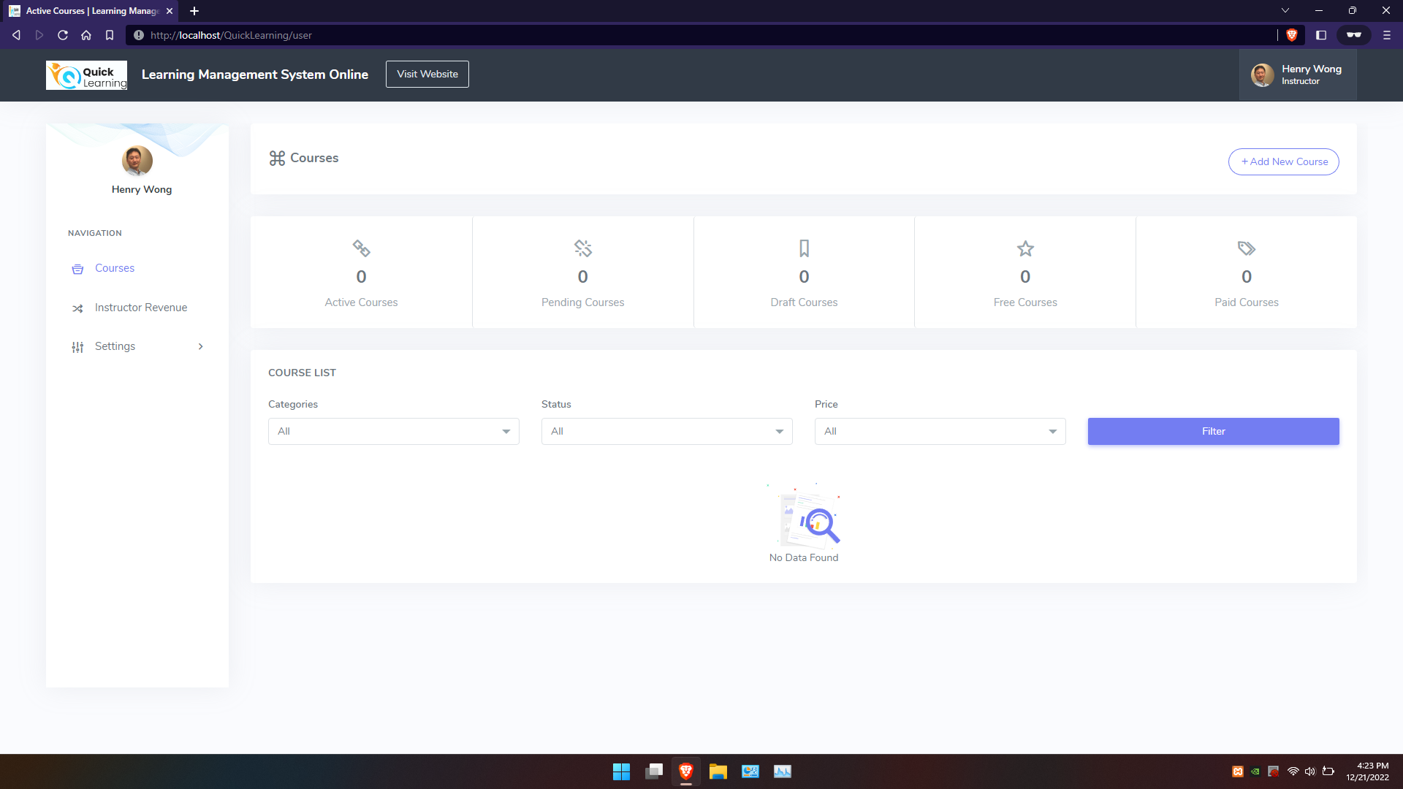
Page for Instructor

Slide 40
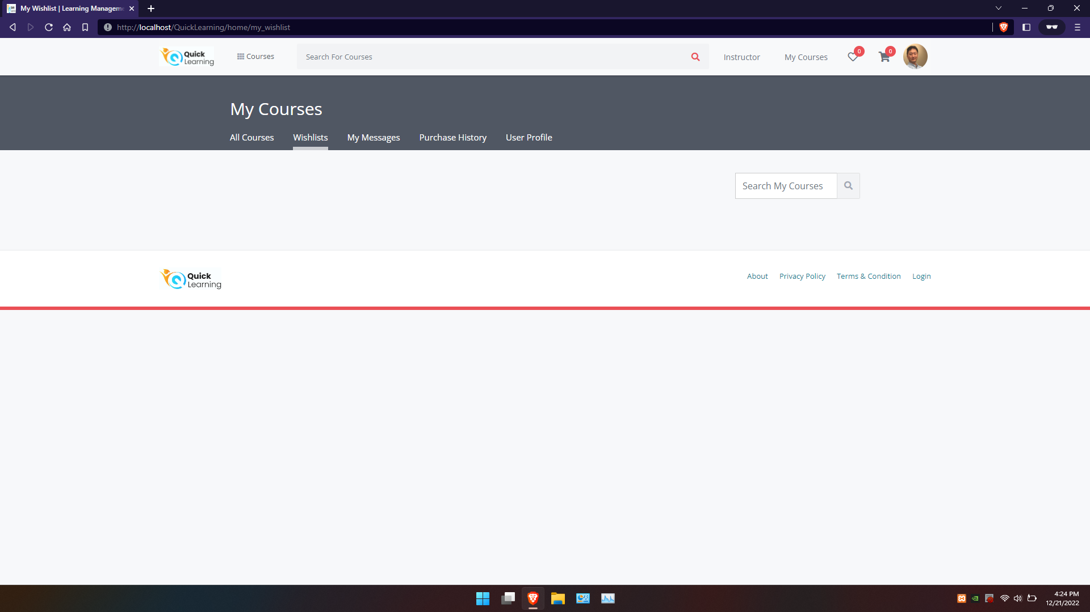
User can Wishlist the course

Slide 41
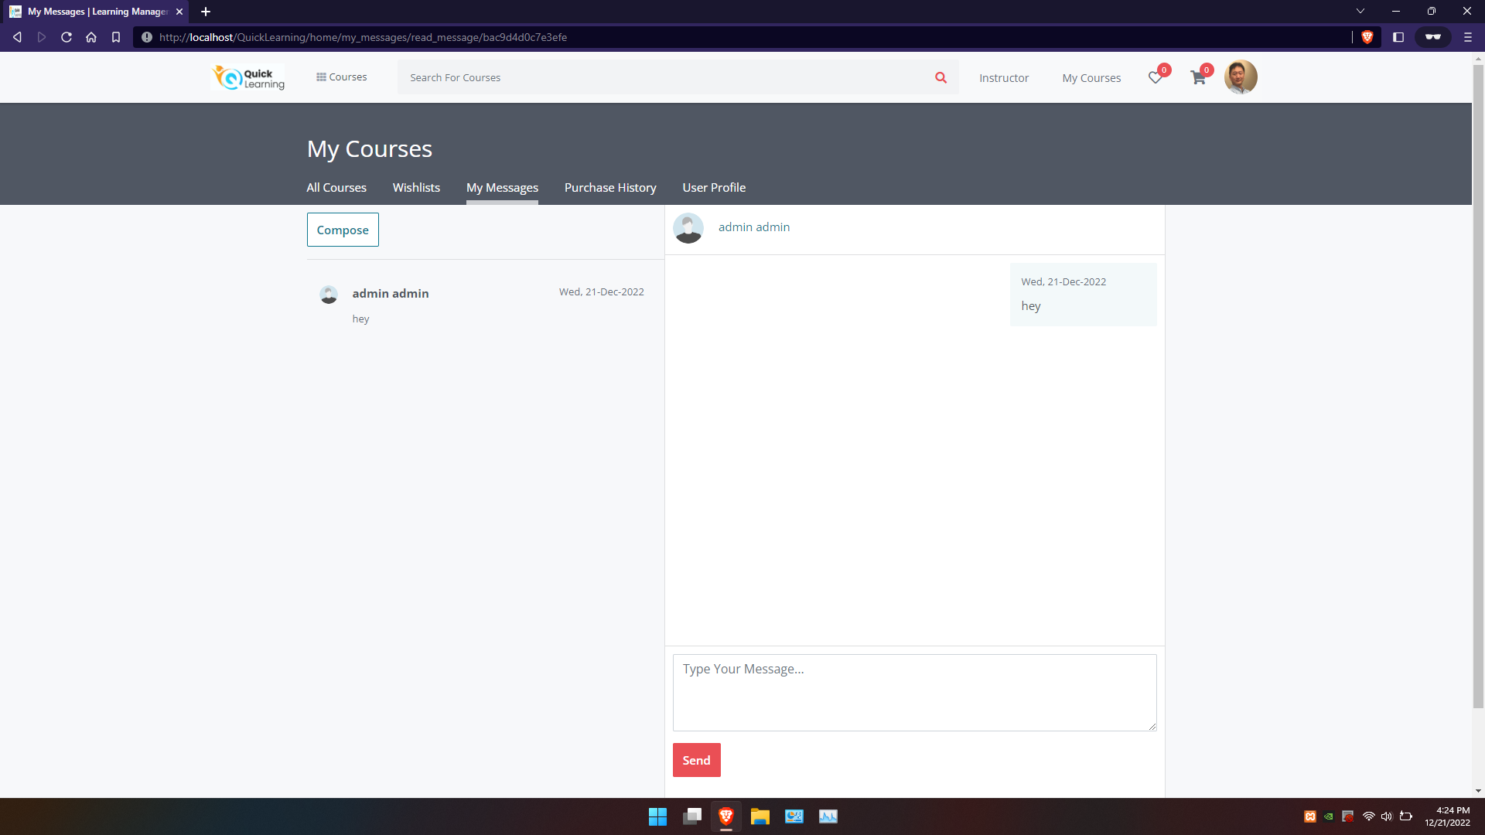
User can send messages

Slide 42
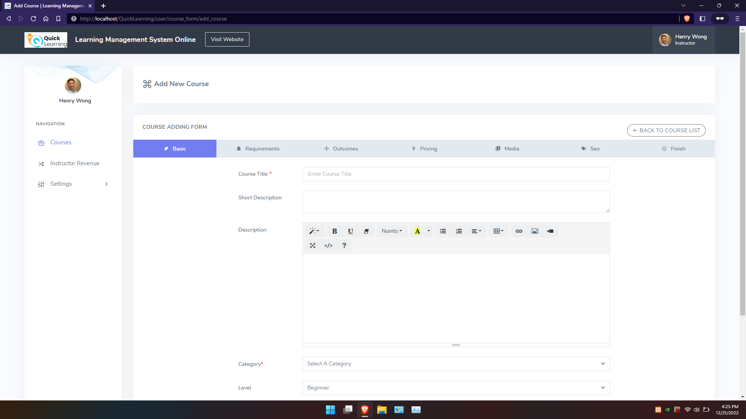
Instructor can add a course

Slide 43
WIKIPAGE LINK:
Click here for the WIKIPAGE

Slide 44

HAPPY LEARNING
Thank You

